Slide 1
Linear Feedback Shift Registers
(LFSR)

Slide 2
LFSR Applications
Pattern Generators
Counters
Built-in Self-Test (BIST)
Encryption
Compression
Checksums
Pseudo-Random Bit Sequences (PRBS)

Slide 3
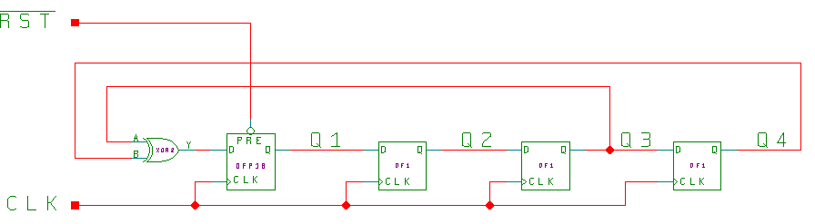
Basic 4-bit LFSR
XOR-Based
These circuits can also be built equivalently with XNOR states, with the “dead” state being all ‘1’s instead of all ‘0’s.

Slide 4
Basic 4-bit LFSR, XOR-Based
Simulation
Reset
Operation
| time = 1000.0ns ~RST=0 Q=1XXX
| time = 2000.0ns ~RST=0 Q=11XX
| time = 3000.0ns ~RST=0 Q=111X
| time = 4000.0ns ~RST=0 Q=1111
| time = 5000.0ns ~RST=0 Q=1111
| time = 6000.0ns ~RST=0 Q=1111
| time = 7000.0ns ~RST=0 Q=1111
| time = 9000.0ns ~RST=1 Q=1111
| time = 10000.0ns ~RST=1 Q=0111 0
| time = 11000.0ns ~RST=1 Q=0011 1
| time = 12000.0ns ~RST=1 Q=0001 2
| time = 13000.0ns ~RST=1 Q=1000 3
| time = 14000.0ns ~RST=1 Q=0100 4
| time = 15000.0ns ~RST=1 Q=0010 5
| time = 16000.0ns ~RST=1 Q=1001 6
| time = 17000.0ns ~RST=1 Q=1100 7
| time = 18000.0ns ~RST=1 Q=0110 8
| time = 19000.0ns ~RST=1 Q=1011 9
| time = 20000.0ns ~RST=1 Q=0101 10
| time = 21000.0ns ~RST=1 Q=1010 11
| time = 22000.0ns ~RST=1 Q=1101 12
| time = 23000.0ns ~RST=1 Q=1110 13
| time = 24000.0ns ~RST=1 Q=1111 14
Range is 0 → 14; 2^{n} states

Slide 5
Number of Taps
For many registers of length n, only two taps are needed, and can be implemented with a single XOR (XNOR) gate.
For some register lengths, for example 8, 16, and 32, four taps are needed. For some hardware architectures, this can be in the critical timing path.
A table of taps for different register lengths is included in the back of this module.

Slide 6
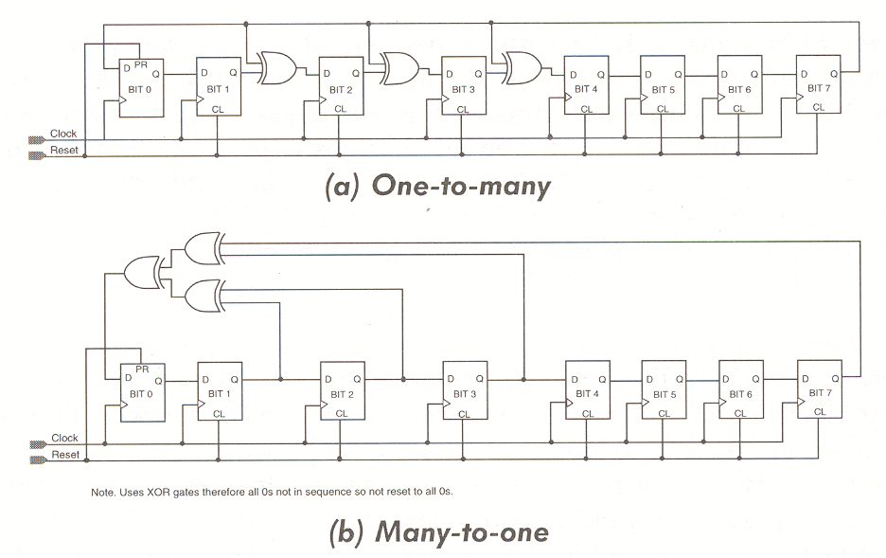
One-to-Many and Many-to-One
Implementation (a) has only a single gate delay between flip-flops.

Slide 7
Effects of Errors
If using a sequence of 2^{n}-1 then there is a potential lockup state
  For XOR LFSRs, lock up state = all 0’s.
  For XNOR LFSRs, lock up state = all 1’s.
Probability of lockup is “relatively” low for large n, as a result of SEU
  # of lockup states = 1
  total # of states = 2^{n}
Solutions:
  use a modified LFSR with 2^{n} states
  implement a watchdog timer

Slide 8
Avoiding the Lockup State
Will Use XOR Form For Examples
We have an n-bit LFSR, shifting to the “right”
n
0

Slide 9
Avoiding the Lockup State
Will Use XOR Form For Examples
The all ‘0’s state can’t be entered during normal operation but we can get close. Here’s one of n examples:
0
0
0
0
0
1
n
0
We know this is a legal state since the only illegal state is all 0’s. If the first n-1 bits are ‘0’, then bit 0 must be a ‘1’.

Slide 10
Avoiding the Lockup State
Will Use XOR Form For Examples
Now, since the XOR inputs are a function of taps, including the bit 0 tap, we know what the output of the XOR tree will be: ‘1’.
It must be a ‘1’ since ‘1’ XOR ‘0’ XOR ‘0’ XOR ‘0’ = ‘1’.
0
0
0
0
0
1
n
0
So normally the next state will be:
1
0
0
0
0
0
n
0

Slide 11
Avoiding the Lockup State
Will Use XOR Form For Examples
But instead, let’s do this, go from this state:
0
0
0
0
0
1
n
0
To the all ‘0’s state:
1
0
0
0
0
0
n
0

Slide 12
Avoiding the Lockup State
Will Use XOR Form For Examples
And then from the newly legal state:
0
0
0
0
0
0
n
0
Back to our regular sequence:
1
0
0
0
0
0
n
0

Slide 13
Avoiding the Lockup State
Will Use XOR Form For Examples
Implementation. First, detect the “almost” state:
0
0
0
0
0
X
n
0
The NOR of these n-1 bits will provide a ‘1’ when they are all ‘0’s and serve as a marker.

Slide 14
Avoiding the Lockup State
New Sequence of States
0
0
0
0
0
1
a)
n
0
0
0
0
0
0
0
b)
n
0
1
0
0
0
0
0
c)
n
0

Slide 15
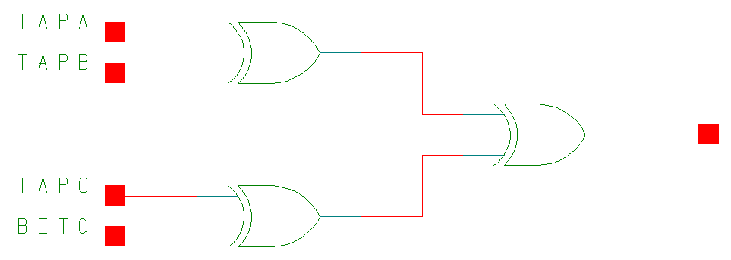
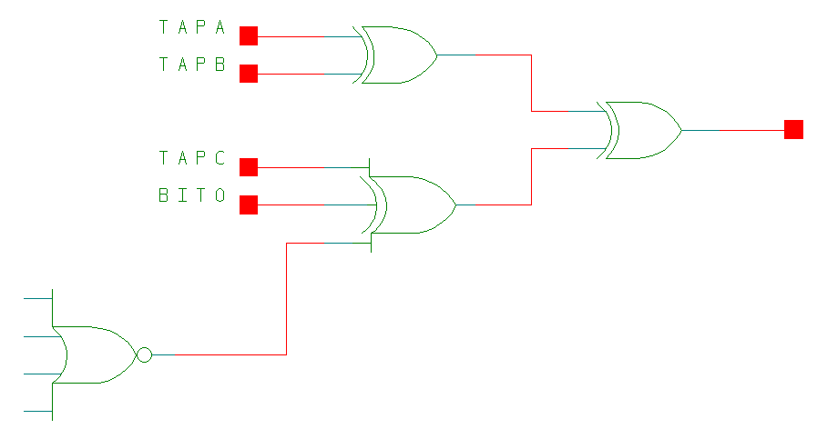
Avoiding the Lockup State
Modification to Circuit
2^{n-1} states
2^{n} states
NOR of all bits
except bit 0
Added this term
a) “000001” : 0 Xor 0 Xor 0 Xor 1 Xor 1 ⇒ 0
b) “000000” : 0 Xor 0 Xor 0 Xor 0 Xor 1 ⇒ 1
c) “100000” :

Slide 16
Making TCO For Long Counters At High Speeds (1)
While the shift and XOR operations are fast, performance may be limited by the decoding of the terminal count out (TCO)
The decoding of the TCO can be pipelined to keep the maximum clock frequency high
Decoding of the all 1’s (or all 0’s) state can be done by counting the consecutive number numbers of 1’s (0’s) shifted.

Slide 17
Making TCO For Long Counters At High Speeds (2)
1 2 n
• • •
Count n
1’s (0’s)
TCO
Basic Scheme

Slide 18
Making TCO For Long Counters At High Speeds - Analysis (3)
Algebraically
  Assume all bits = ‘1’
  XOR function has a fan-in of either 2 or 4
  Next bit shifted in will be a zero
    TCO can’t end too late
    The previous bit shifted out was a ‘0’
    Otherwise bit 1 wouldn’t be a ‘1’
    TCO can’t start too early
Logically
  A string of n+1 1’s ⇒ an extra lockup state

Slide 19
Making TCO For Long Counters At High Speeds - Analysis (4)
Period of LFSR is proportional to 2^{n}
Comparison of LFSR is proportional to n
Comparison of TCO counter is proportional to log₂n
Example
n = 64
f = 1 MHz
t = 584,942.4 years

Slide 20
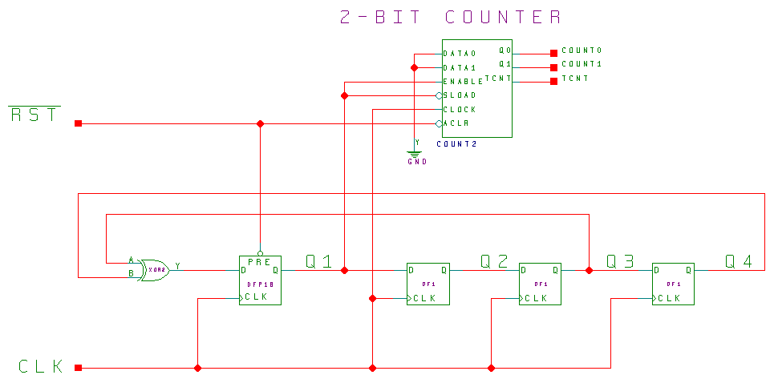
Making TCO For Long Counters At High Speeds - Example (5)

Slide 21
Making TCO For Long Counters At High Speeds - Example (6)
|time = 7000.0ns ~RST=0 Q=1111 TCNT=0 COUNT=0\H
|time = 8000.0ns ~RST=0 Q=1111 TCNT=0 COUNT=0\H
|time = 9000.0ns ~RST=1 Q=1111 TCNT=0 COUNT=0\H
|time = 10000.0ns ~RST=1 Q=0111 TCNT=0 COUNT=1\H 0
|time = 11000.0ns ~RST=1 Q=0011 TCNT=0 COUNT=0\H 1
|time = 12000.0ns ~RST=1 Q=0001 TCNT=0 COUNT=0\H 2
|time = 13000.0ns ~RST=1 Q=1000 TCNT=0 COUNT=0\H 3
|time = 14000.0ns ~RST=1 Q=0100 TCNT=0 COUNT=1\H 4
|time = 15000.0ns ~RST=1 Q=0010 TCNT=0 COUNT=0\H 5
|time = 16000.0ns ~RST=1 Q=1001 TCNT=0 COUNT=0\H 6
|time = 17000.0ns ~RST=1 Q=1100 TCNT=0 COUNT=1\H 7
|time = 18000.0ns ~RST=1 Q=0110 TCNT=0 COUNT=2\H 8
|time = 19000.0ns ~RST=1 Q=1011 TCNT=0 COUNT=0\H 9
|time = 20000.0ns ~RST=1 Q=0101 TCNT=0 COUNT=1\H 10
|time = 21000.0ns ~RST=1 Q=1010 TCNT=0 COUNT=0\H 11
|time = 22000.0ns ~RST=1 Q=1101 TCNT=0 COUNT=1\H 12
|time = 23000.0ns ~RST=1 Q=1110 TCNT=0 COUNT=2\H 13
|time = 24000.0ns ~RST=1 Q=1111 TCNT=1 COUNT=3\H 14
|time = 25000.0ns ~RST=1 Q=0111 TCNT=0 COUNT=0\H 0
|time = 26000.0ns ~RST=1 Q=0011 TCNT=0 COUNT=0\H 1

Slide 22
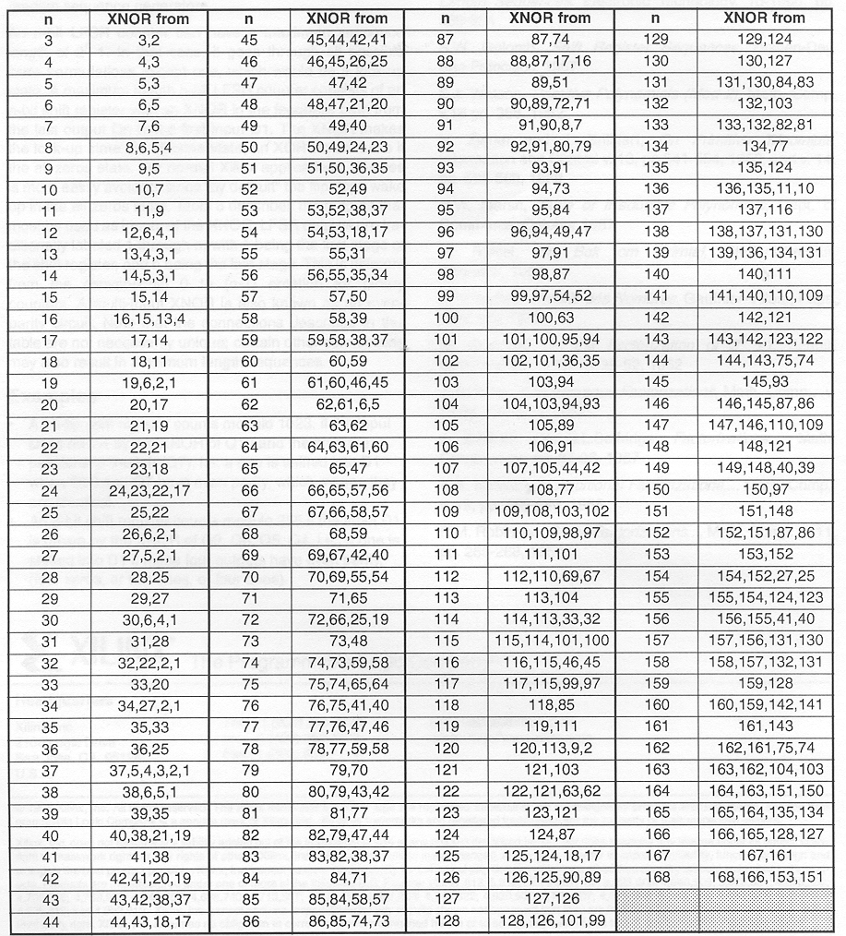
Taps for Maximum Length
LFSR Counters (1)

Slide 23
Taps for Maximum Length
LFSR Counters (2)

Slide 24
References
The Art of Electronics, 2nd Edition, Horowitz and Hill, 1989, pp. 665-667
P. Alfke, “Efficient Shift Registers, LFSR, Counters, and Long Pseudo-Random Sequence Generators,” XAPP 052, July 7,1996 (Version 1.1)
HDL Chip Design, Douglas J. Smith, Doone Publications, 1996.

